Slide 1
MARKET TRENDS AND MACHINE LEARNING: A House Price Prediction Model
Presented by:
Tibawo Timuhwe
Tshiamo Chibua
Wame Oduetse
Oabile Moroka
Phenyo Sithelo

Slide 2
Background of Study and problem statement
As we know in today’s world the real estate market is influenced by a variety of factors, including geographical location, economic conditions, and the specific characteristics of properties. Traditional methods of property assessment are often time-consuming, subjective, and may not fully capture the complex and non-linear interactions between these factors.
Due to this we have decided to start a project on developing a robust model for house price prediction which supports both statistical and machine learning techniques relevant to the study.

Slide 3
Aims & objectives
Aim :
To develop a machine learning model that accurately predicts house prices.
Objectives :
Analyze market trends and property features
Apply statistical and machine learning methods
Evaluate model performance using appropriate metrics

Slide 4
LITERATURE REVIEW
Machine learning outperforms traditional valuation methods.
Techniques used: Random Forest, ANN, SVR, Decision Trees.
Evaluation metrics: RMSE, MAE, R^2.
Importance of geocoding and feature selection.
Studies show hybrid models improve performance.

Slide 5
METHODOLOGY
Framework: CRISP-DM (Business Understanding to Deployment).
Data Collection: Real estate listings, government datasets.
Preprocessing: Missing value handling, normalization, encoding.
Modeling: Random Forest, Linear Regression.
Evaluation: RMSE, MAE, R^2.

Slide 6
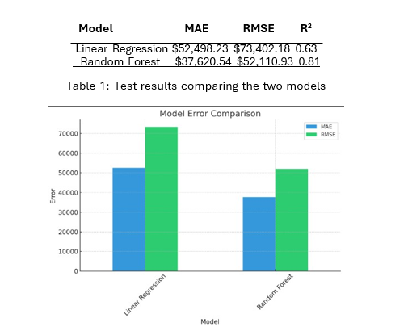
Results: Model Performance
Linear Regression:
- R²: 0.63
- MAE: $52,498
- RMSE: $73,402
Random Forest:
- R²: 0.81
- MAE: $37,621
- RMSE: $52,111

Slide 7
Results: Feature Importance
- Median income, housing age, and ocean proximity were top predictors
- SHAP values used to rank importance
- High interpretability aligns with stakeholder needs

Slide 8
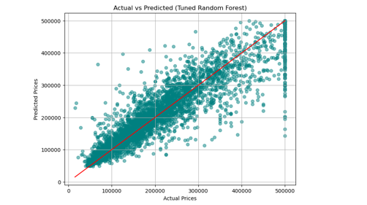
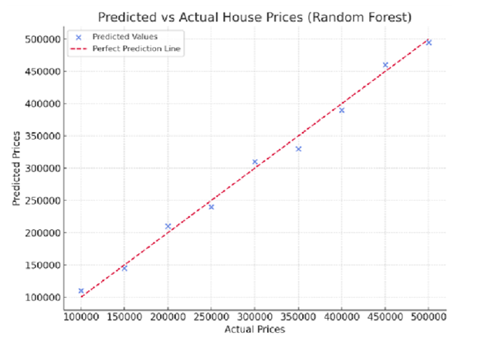
Results: Visualization
Scatter plot shows Random Forest predictions closely align with actual values
Most dots lie near the ideal prediction line

Slide 9
Results: Outliers and Cleaning
Outliers:
IQR method used:
Q1 - 1.5 * IQR or Above Q3 + 1.5 * IQR
Improved model robustness.
Data imputations:
Median used to fill missing values:
Histogram Comparison:
Before Imputation: Irregular, skewed distributions.
After Imputation: Smoother, more symmetrical data profiles.

Slide 10
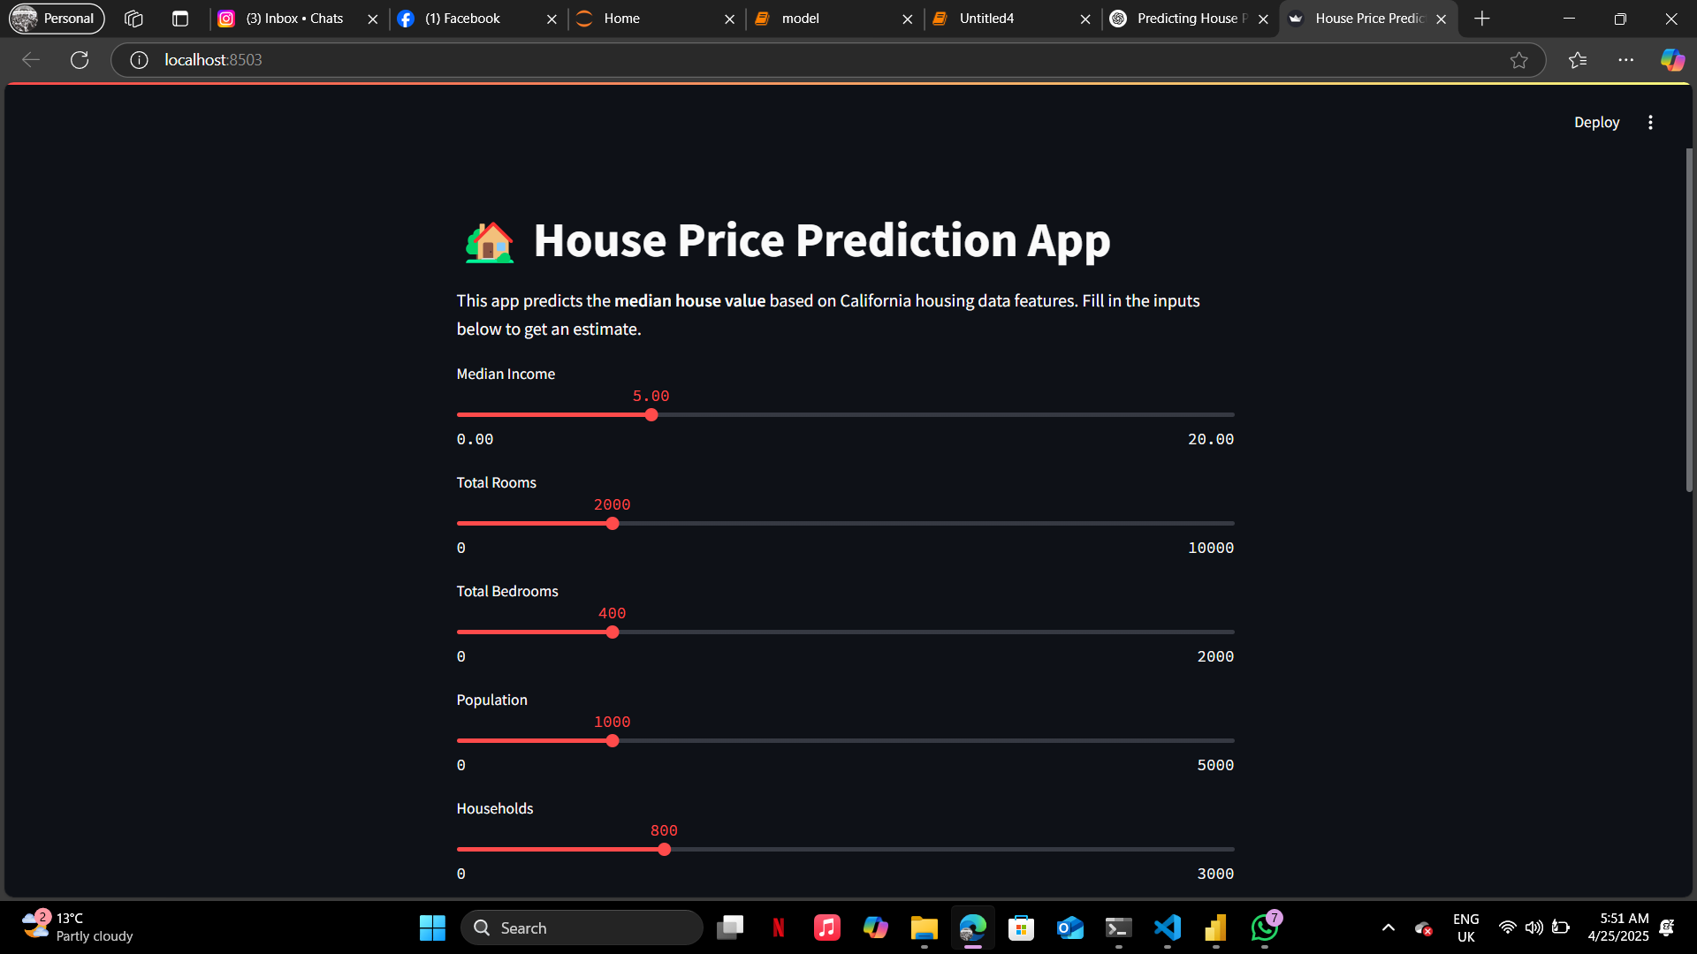
Results: Deployment
Final model deployed via Streamlit web app
Real-time input and output
Stakeholders can interact with predictions visually

Slide 11
Discussion of Findings
Random Forest outperformed due to non-linear capability
-Ensemble averaging reduced error
Useful for investors, policymakers, buyers

Slide 12
Recommendations and future work
Use more advanced models such as XGBoost, hybrid models.
Include more property and macroeconomic features.
Develop a user-friendly web or mobile interface.
Incorporate real-time data feeds for dynamic prediction.
Use a bigger dataset

Slide 13
conclusion
Machine learning, especially Random Forest, is effective for house price prediction.
The CRISP-DM framework ensured a structured approach.
Future improvements can enhance prediction accuracy and application reach which is beneficial and more effective.

Slide 14
Any questions?

